Slide 1
Machine Learning
Dr. Shazzad Hosain
Department of EECS
North South Universtiy
shazzad@northsouth.edu

Slide 2
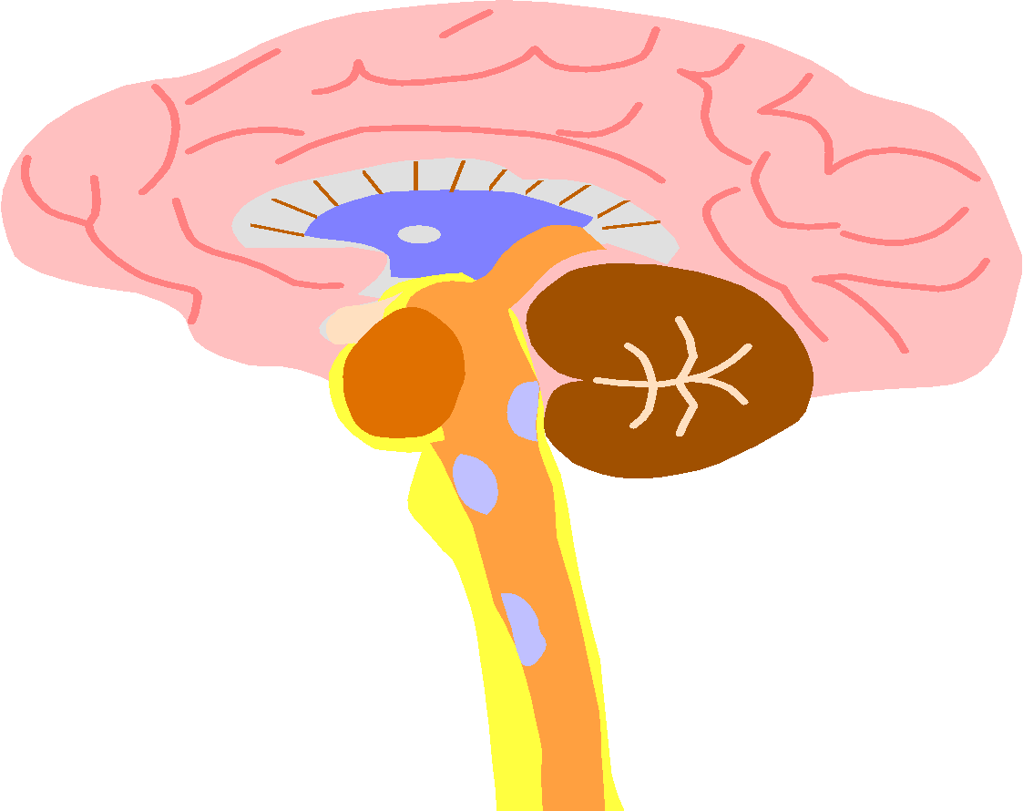
Biological inspiration
Animals are able to react adaptively to changes in their external and internal environment, and they use their nervous system to perform these behaviours.
An appropriate model/simulation of the nervous system should be able to produce similar responses and behaviours in artificial systems.
The nervous system is build by relatively simple units, the neurons, so copying their behavior and functionality should be the solution.

Slide 3
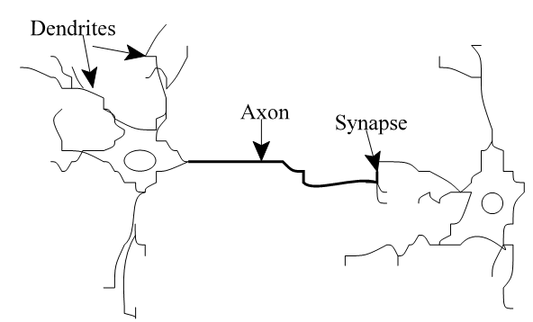
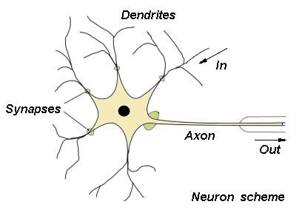
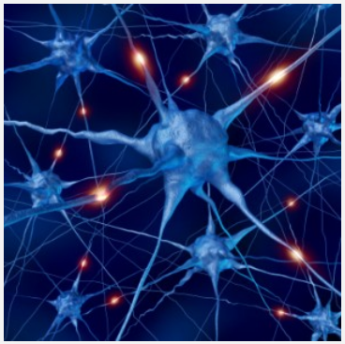
The Structure of
Neurons
‹#›

Slide 4
The Structure of Neurons
A neuron only fires if its input signal exceeds a certain amount (the threshold) in a short time period.
Synapses play role in formation of memory
Two neurons are strengthened when both neurons are active at the same time
The strength of connection is thought to result in the storage of information, resulting in memory.
Synapses vary in strength
Good connections allowing a large signal
Slight connections allow only a weak signal.
Synapses can be either excitatory or inhibitory.
‹#›

Slide 5
Definition of Neural Network
A Neural Network is a system composed of
many simple processing elements operating in
parallel which can acquire, store, and utilize
experiential knowledge.

Slide 6

Features of the Brain
Ten billion (10¹⁰) neurons
Neuron switching time >10⁻³secs
Face Recognition ~0.1secs
On average, each neuron has several thousand connections
Hundreds of operations per second
High degree of parallel computation
Distributed representations
Die off frequently (never replaced)
Compensated for problems by massive parallelism
‹#›

Slide 7

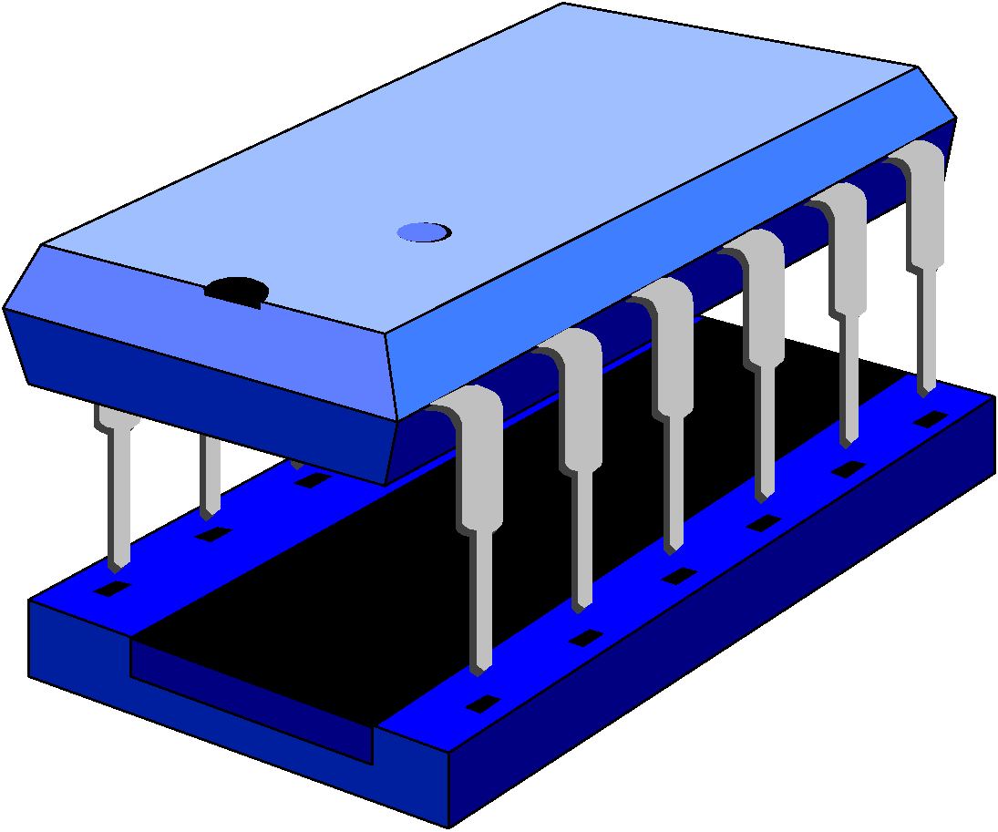
Brain vs. Digital Computer
The Von Neumann architecture uses a single processing unit;
Tens of millions of operations per second
Absolute arithmetic precision
The brain uses many slow unreliable processors acting in parallel
‹#›

Slide 8
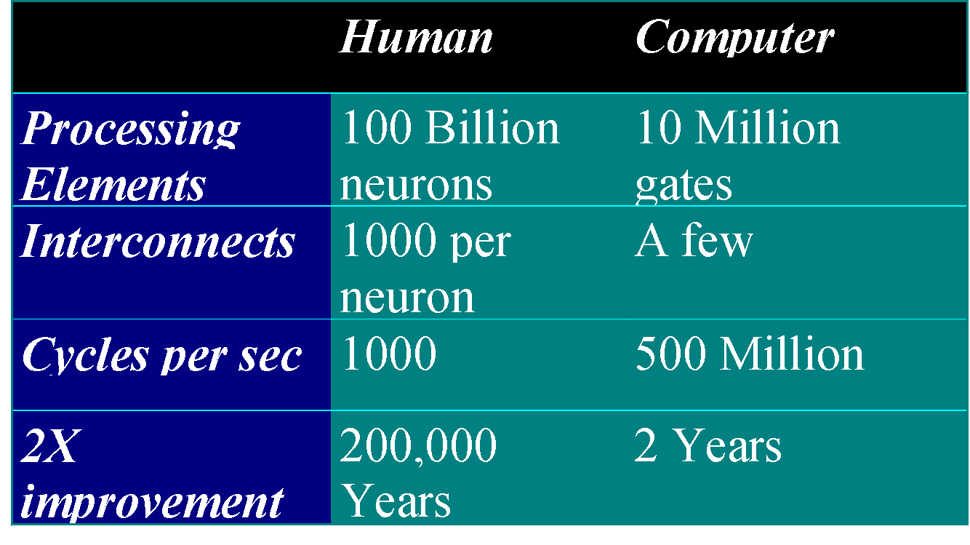
Brain vs. Digital Computer

Slide 9
What is Artificial Neural Network

Slide 10
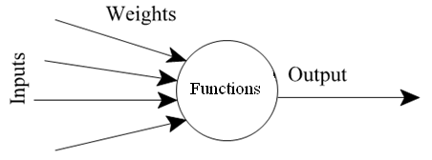
Neurons vs. Units (1)
Each element of NN is a node called unit.
Units are connected by links.
- Each link has a numeric weight.

Slide 11
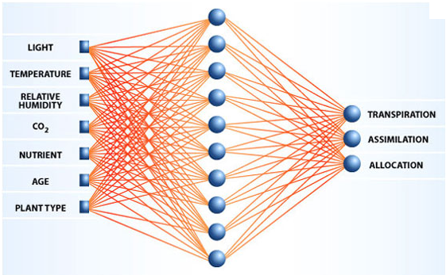
Biological NN vs. Artificial NN
NASA: A Prediction of Plant Growth in Space

Slide 12
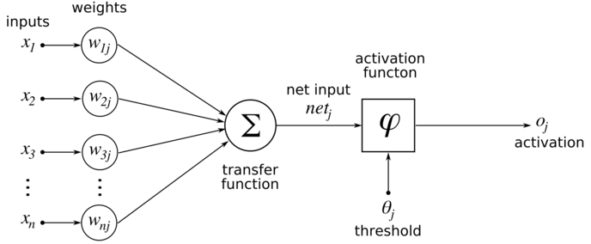
Neuron or Node
Transfer Function
Activation Function
Activation Level or Threshold

Slide 13
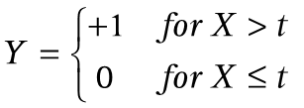

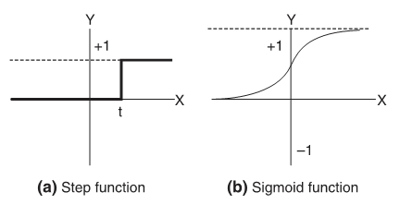
Neuron or Node
Transfer Function
Activation Function
Activation Level or Threshold

Slide 14


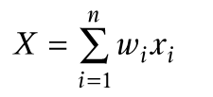
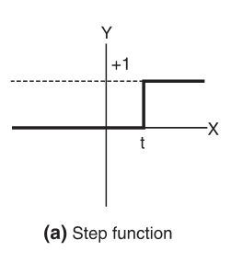
Neuron or Node
=
Transfer Function
Activation Function
Activation Level or Threshold

Slide 15
Perceptron
A simple neuron used to classify inputs into one of two categories
Transfer Function
Activation Function
Activation Level or Threshold

Slide 16



Start with random weights of w₁, w₂
Calculate X, apply Y and find output
If output is different than target then
Find error as e = target – output
If a is the learning rate, where
Then adjust w_{i} as
How Perceptron Learns?

Slide 17
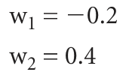
Training Perceptrons
Let us learn logical – OR function for two inputs, using threshold of zero (t = 0) and learning rate of 0.2
x₁ | x₂ | output
0 | 0 | 0
0 | 1 | 1
1 | 0 | 1
1 | 1 | 1
Initialize weights to a random value between -1 and +1
First training data x₁ = 0, x₂ = 0 and expected output is 0
Apply the two formula, get X = (0 x – 0.2) + (0 x 0.4) = 0
Therefore Y = 0, so no error, i.e. e =0
So no change of threshold or no learning

Slide 18
Training Perceptrons
Let us learn logical – OR function for two inputs, using threshold of zero (t = 0) and learning rate of 0.2
x₁ | x₂ | output
0 | 0 | 0
0 | 1 | 1
1 | 0 | 1
1 | 1 | 1
Now, for x₁ = 0, x₂ = 1 and expected output is 1
Apply the two formula, get X = (0 x – 0.2) + (1 x 0.4) = 0.4
Therefore Y = 1, so no error, i.e. e =0
So no change of threshold or no learning

Slide 19
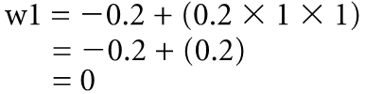

Training Perceptrons
Let us learn logical – OR function for two inputs, using threshold of zero (t = 0) and learning rate of 0.2
x₁ | x₂ | output
0 | 0 | 0
0 | 1 | 1
1 | 0 | 1
1 | 1 | 1
0
Now, for x₁ = 1, x₂ = 0 and expected output is 1
Apply the two formula, get X = (1 x – 0.2) + (0 x 0.4) = – 0.2
Therefore Y = 0, so error, e = (target – output) = 1 – 0 = 1
So change weights according to
W2 not adjusted, because it did not contributed to error

Slide 20
Training Perceptrons
Let us learn logical – OR function for two inputs, using threshold of zero (t = 0) and learning rate of 0.2
x₁ | x₂ | output
0 | 0 | 0
0 | 1 | 1
1 | 0 | 1
1 | 1 | 1
0
Now, for x₁ = 1, x₂ = 1 and expected output is 1
Apply the two formula, get X = (0 x – 0.2) + (1 x 0.4) = 0.4
Therefore Y = 1, so no error, no change of weights
This is the end of first epoch
The method runs again and repeat until classified correctly

Slide 21
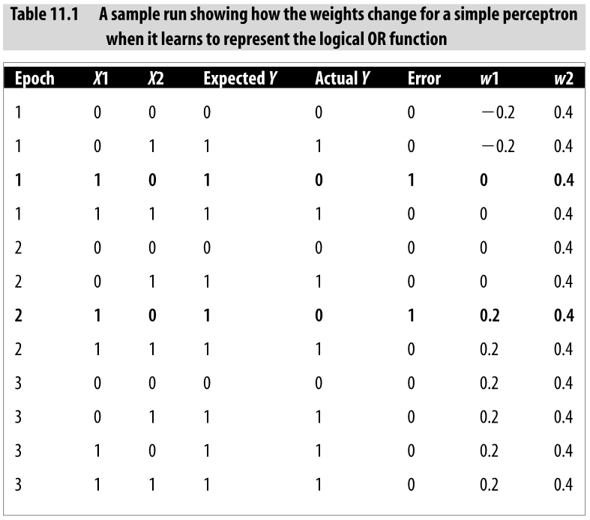

Slide 22
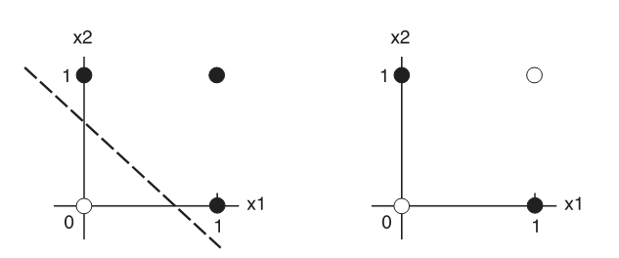
Linear Separability
Perceptrons can only learn models that are linearly separable
Thus it can classify AND, OR functions but not XOR
OR
XOR
However, most real-world problems are not linearly separable

Slide 23
Multilayer Neural Networks

Slide 24
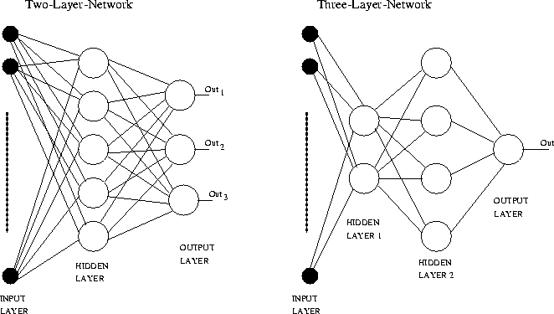
Multilayer Feed Forward NN
Examples architectures
http://www.teco.uni-karlsruhe.de/~albrecht/neuro/html/node18.html

Slide 25
Multilayer Feed Forward NN
Hidden layers solve the classification problem for non linear sets
The additional hidden layers can be interpreted geometrically as additional hyper-planes, which enhance the separation capacity of the network
How to train the hidden units for which the desired output is not known.
The Backpropagation algorithm offers a solution to this problem

Slide 26
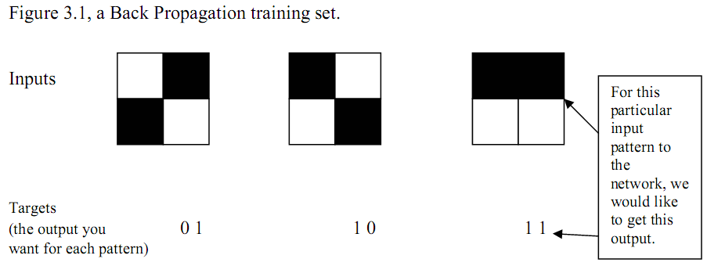
Back Propagation Algorithm

Slide 27
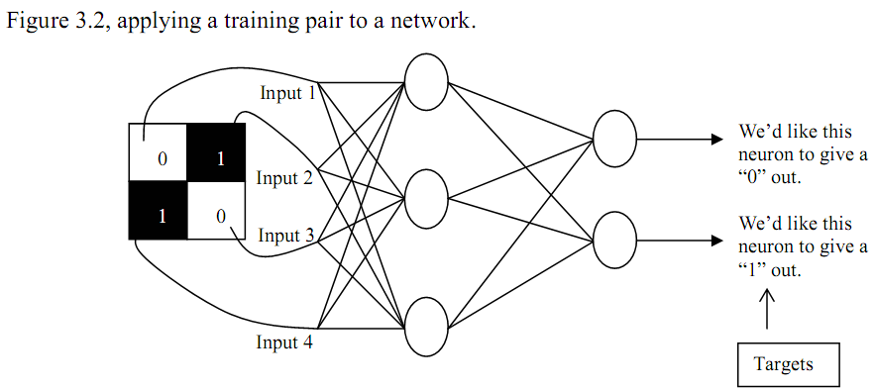
Back Propagation Algorithm
The network is initialized with weights
Next, the input pattern is applied and output is calculated (forward pass)
If error, then adjust the weights so that error will get smaller
Repeat the process until the error is minimal

Slide 28
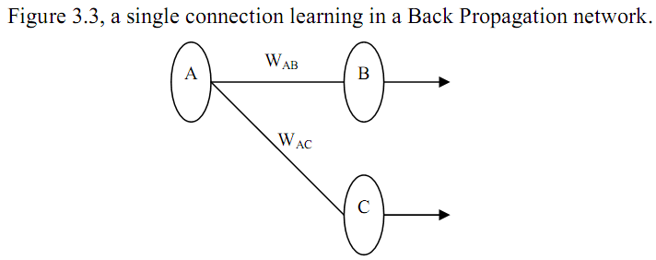
Back Propagation Algorithm
Initialize network with weights, work out the output
Find the error for neuron B
Output (1 – Output) is necessary for sigmoid function, otherwise it would be (Target – Output), explained latter on

Slide 29
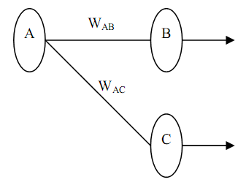

Back Propagation Algorithm
Initialize network with weights, work out the output
Find the error for neuron B
Change the weight. Let W⁺_{AB} be the new weight of W_{AB}
Calculate the Errors for the hidden layer neurons
Hidden layers do not have output target, So calculate error from output errors
Now, go back to step 3 to change the hidden layer weights

Slide 30
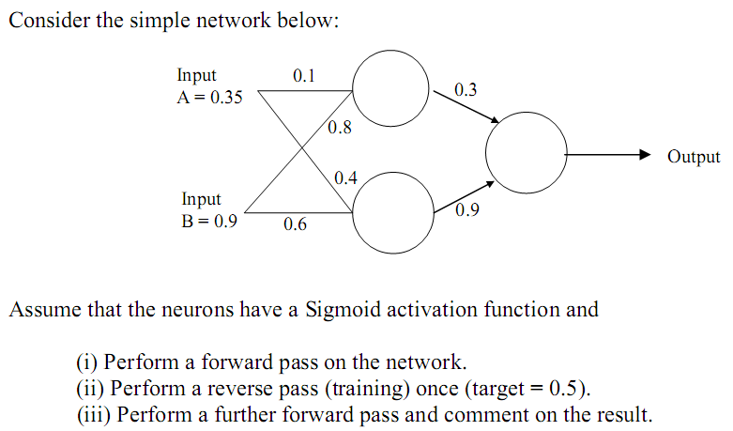
Back Propagation Algorithm Example

Slide 31
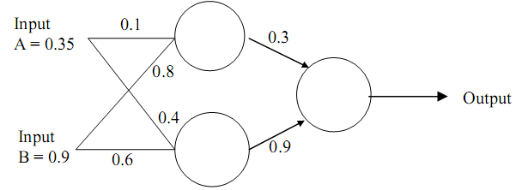
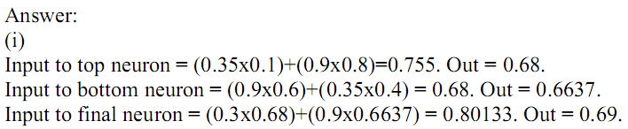
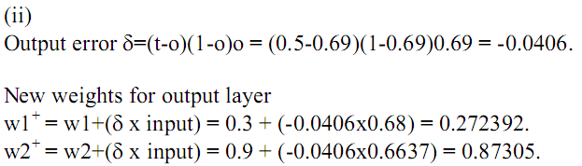
Back Propagation Algorithm Example

Slide 32

Back Propagation Algorithm Example

Slide 33
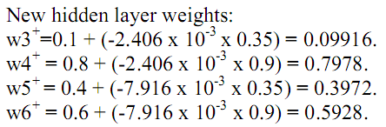
Back Propagation Algorithm Example

Slide 34
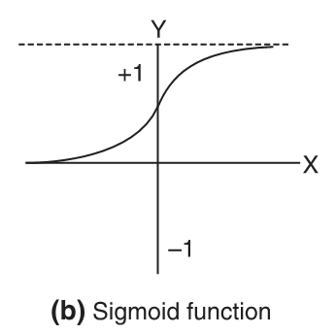

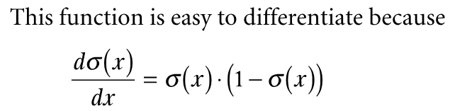
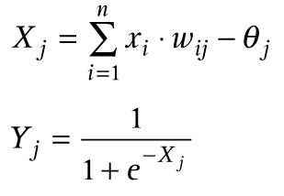

Gradient Descent Method
The sigmoid function
is the threshold value used for node j
Let, i represents node of input layer, j for hidden layer nodes and k for output layer nodes, then
Error signal
Where d_{k} is the desired value and y_{k} is the output

Slide 35

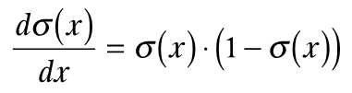

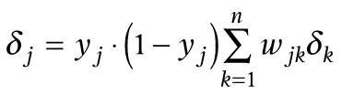
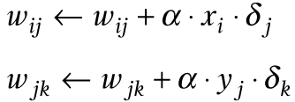
Gradient Descent Method
Error gradient for output node k is:
Since y is defined as the sigmoid function of x and
Similarly, error gradient for each node j in the hidden layer, as follows
Now each weight in the network, w_{ij} or w_{jk} is updated, as follows

Slide 36
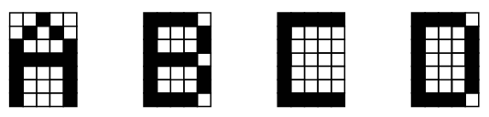
More Example
Train the first four letters of the alphabet

Slide 37
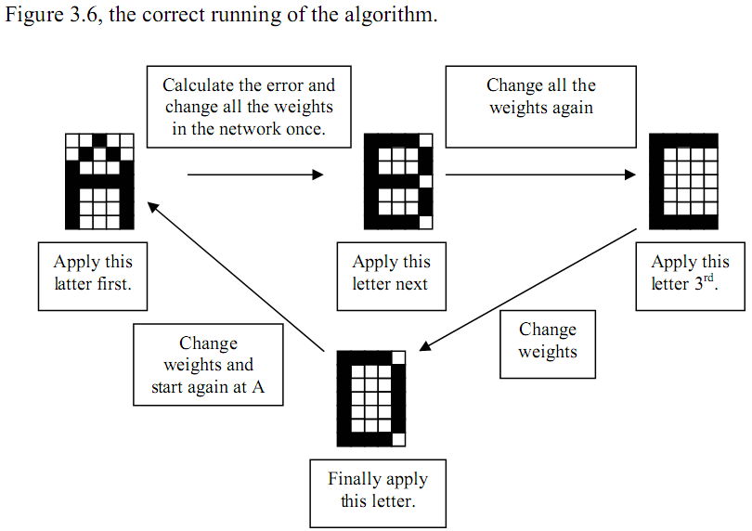
More Example

Slide 38
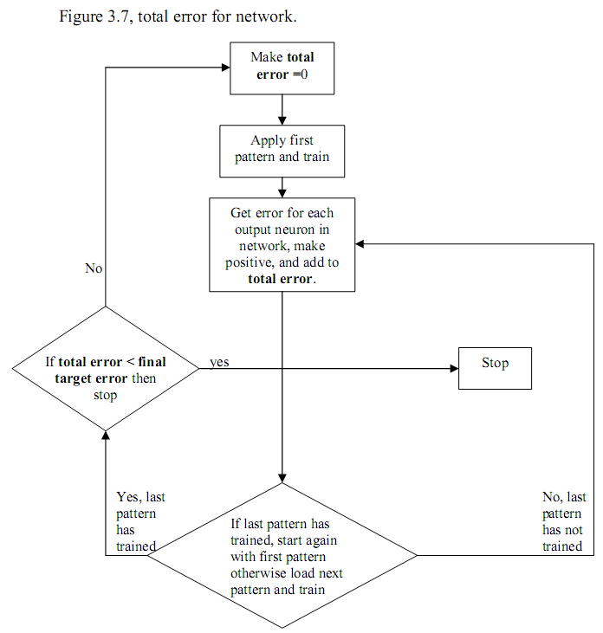
Stopping Training
When to stop training?
Network recognizes all characters successfully
In practice, let the error fall to a lower value
This ensures all
are being well
recognized

Slide 39
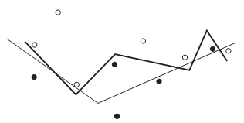
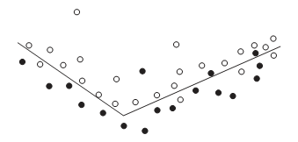
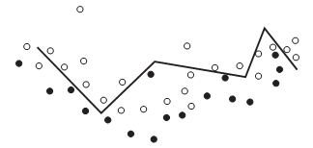
Stopping training with Validation Set
This stops overtraining or over fitting problem
Black dots are positive, others negative
Two lines represent two hypothesis
Thick line is complex hypothesis correctly classifies all data
Thin line is simple hypothesis but incorrectly classifies some data
The simple hypothesis makes some errors but reasonably closely represents the trend in the data
The complex solution does not at all represent the full set of data
let the error fall to a lower value

Slide 40
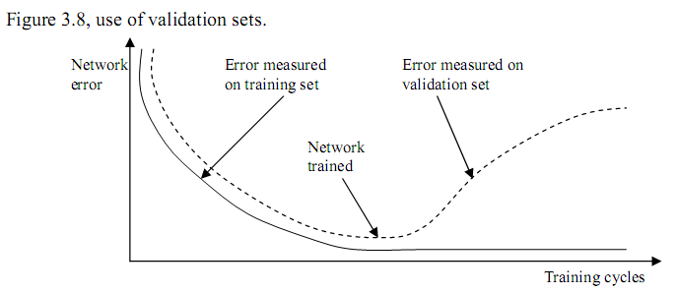
Over fitting problem
When over trained (becoming too accurate) the validation set error starts rising.
If over trained it won’t be able to handle noisy data so well

Slide 41
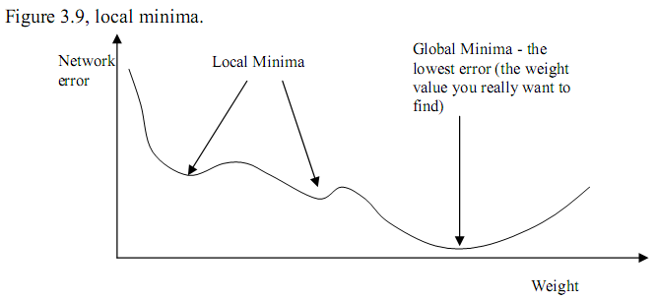
Problems with Backpropagation
Stuck with local minima
Because, algorithm always changes to cause the error to fall
One solution is to start with different random weights, train again
Another solution is to use momentum to the weight change
Weight change of an iteration depends on previous change

Slide 42

Network Size
Most common use is one input, one hidden and one output layer, Input output depends on problem
Let we like to recognize 5x7 grid (35 inputs) characters and 26 such characters (26 outputs)
Number of hidden units and layers
No hard and fast rule. For above problem 6 – 22 is fine
With ‘traditional’ back-propagation a long NN gets stuck in local minima and does not learn well

Slide 43
Strengths and Weakness of BP
Recognize patterns of the example type we provided (usually better than human)
It can’t handle noisy data like face in a crowd
In that case data preprocessing is necessary

Slide 44
References
Chapter 11 of “AI Illuminated” by Ben Coppin.
PDF provided in class

